Slide 1
How I Found my Passion for Enterprise Developer Tools
50 slides x 20 seconds = 1,000 / 60 = 16 minutes
Alan Underwood, June 28 – Nice to MEME you!

Slide 2
Hi, I’m Alan!

Slide 3


Slide 4


Slide 5
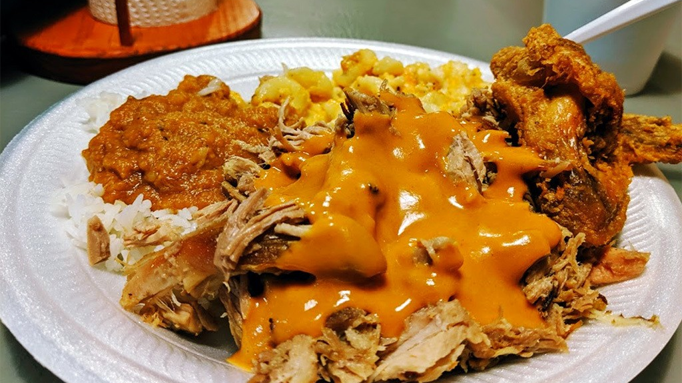

Slide 6
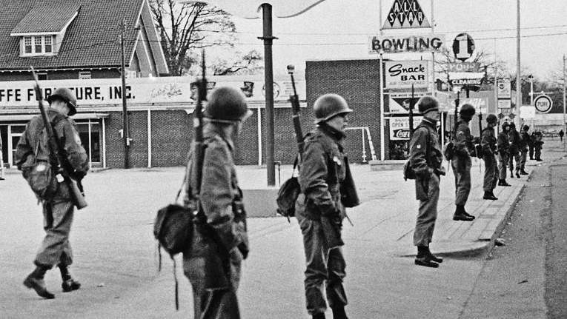

Slide 7
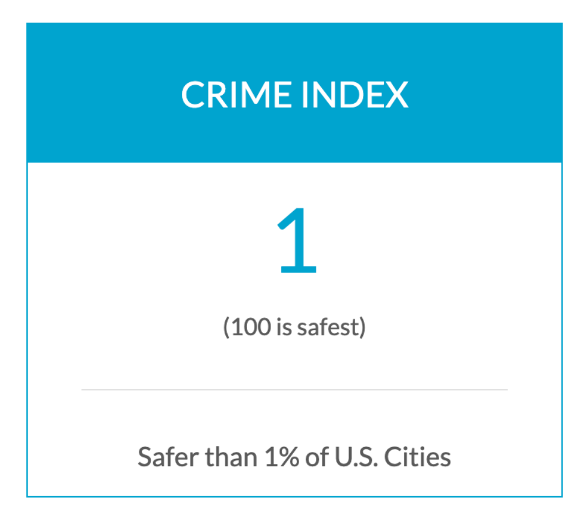
Orangeburg is not good place…
Orangeburg, South Carolina was at one point both the “crack capital” and the “murder capital” of the United States... simultaneously.
The crime rate in Orangeburg is higher than 99% of all US cities and 431% higher than the national avg.
Columbia, SC was listed in the top ten most dangerous places in the country by the FBI in 2023.

Slide 8


Slide 9
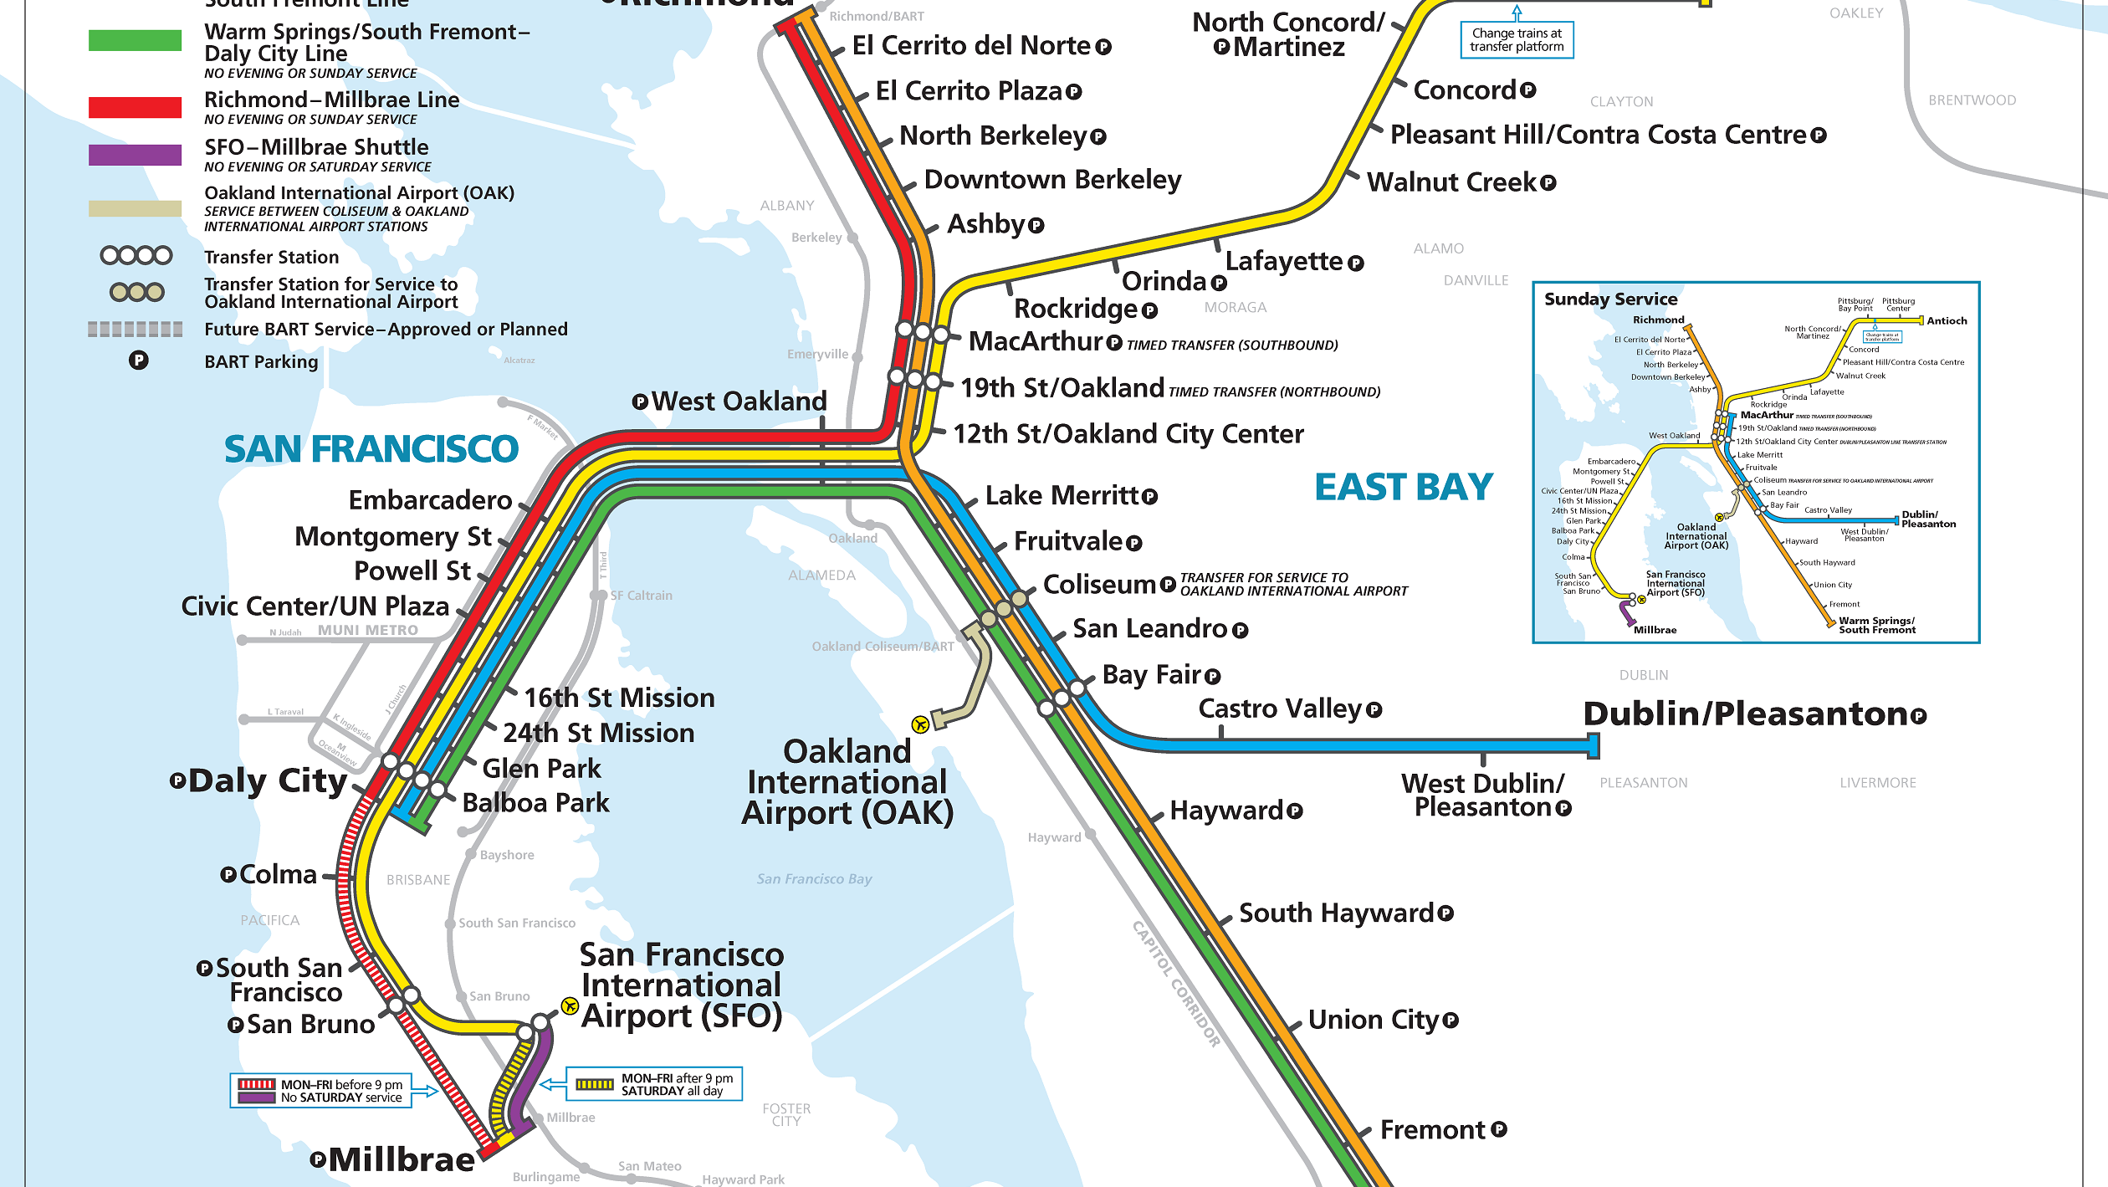
OAKLAND

Slide 10


Slide 11


Slide 12
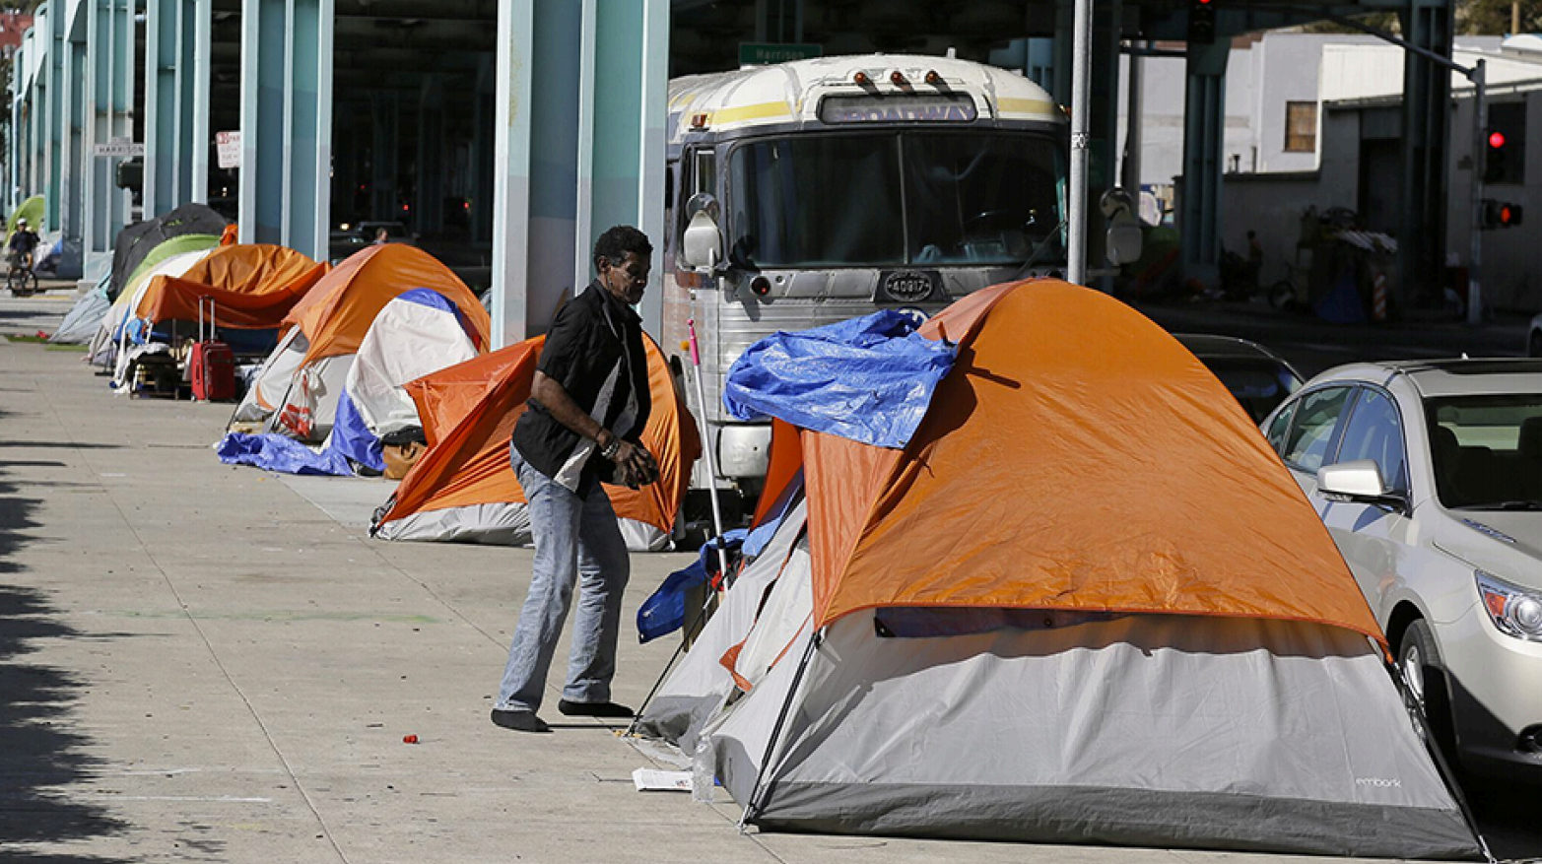

Slide 13
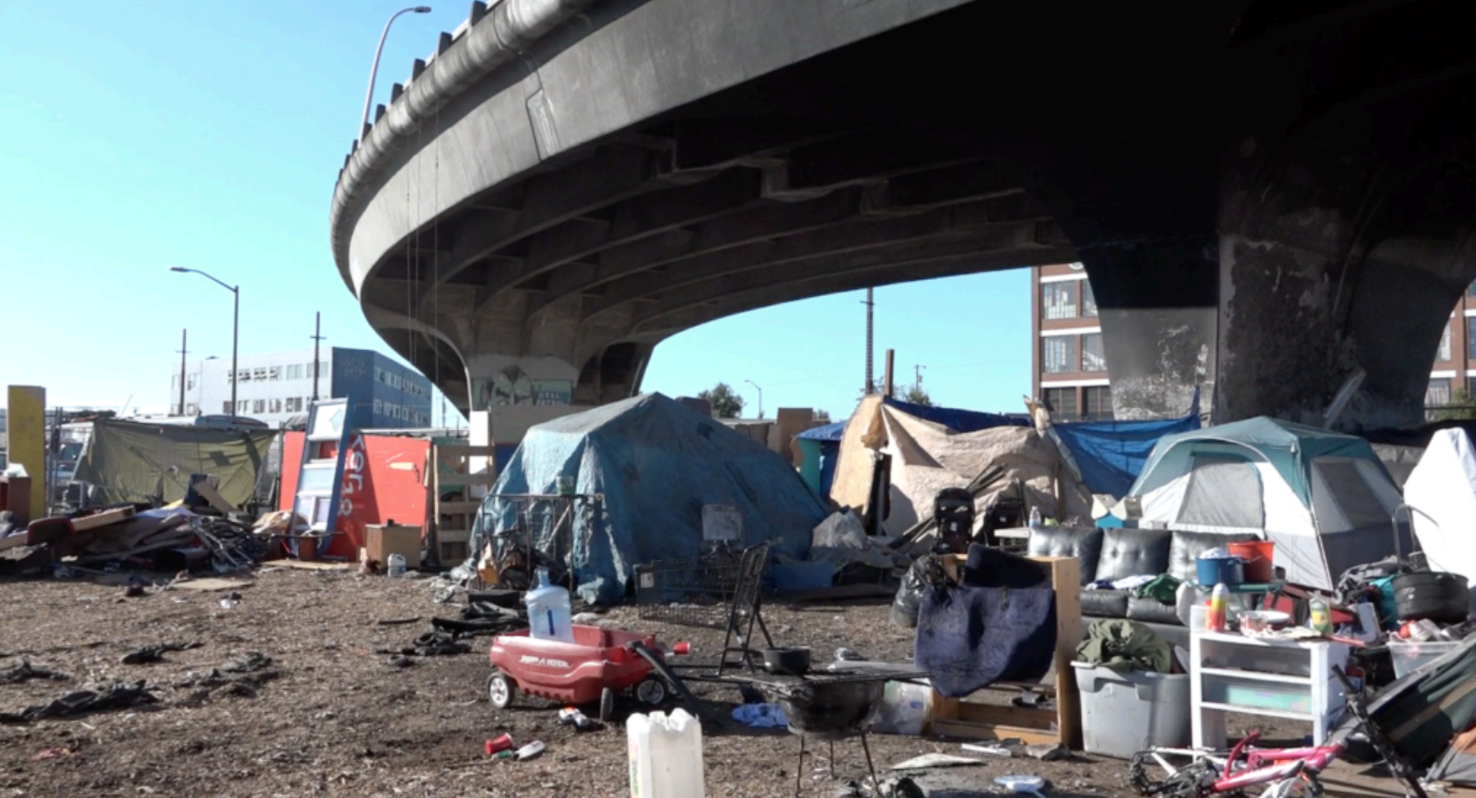

Slide 14
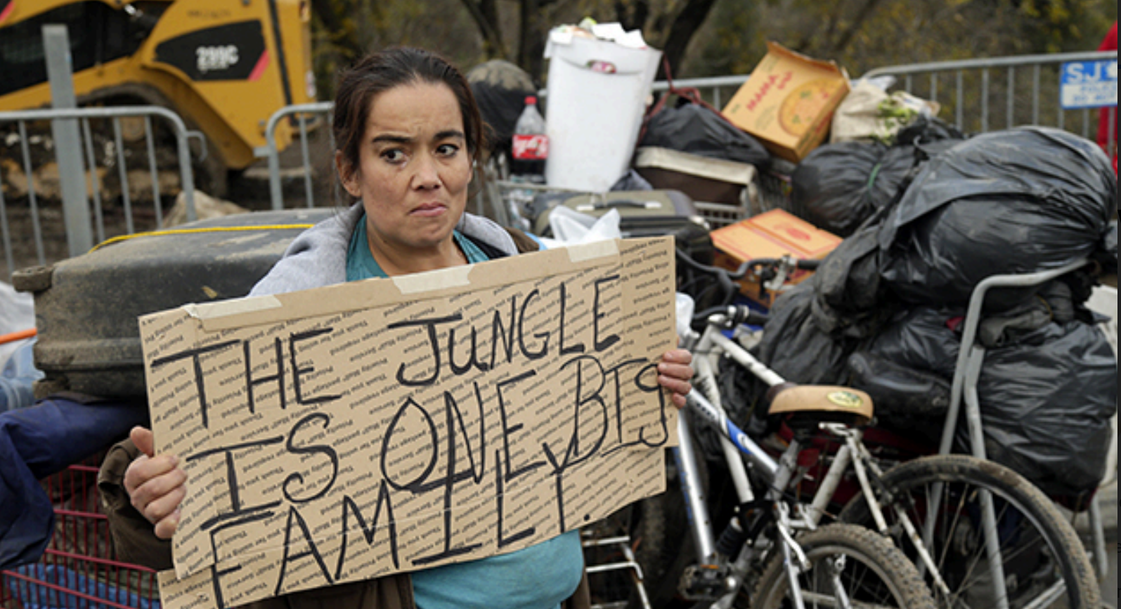

Slide 15
What does any of this have to do with enterprise software development?

Slide 16


Slide 17
Over the past 20 years, I have designed a TON of enterprise development tools

Slide 18
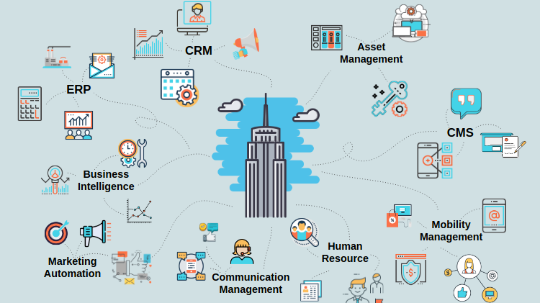

Developer
Tools

Slide 19
We’re even using one of them here!

Slide 20
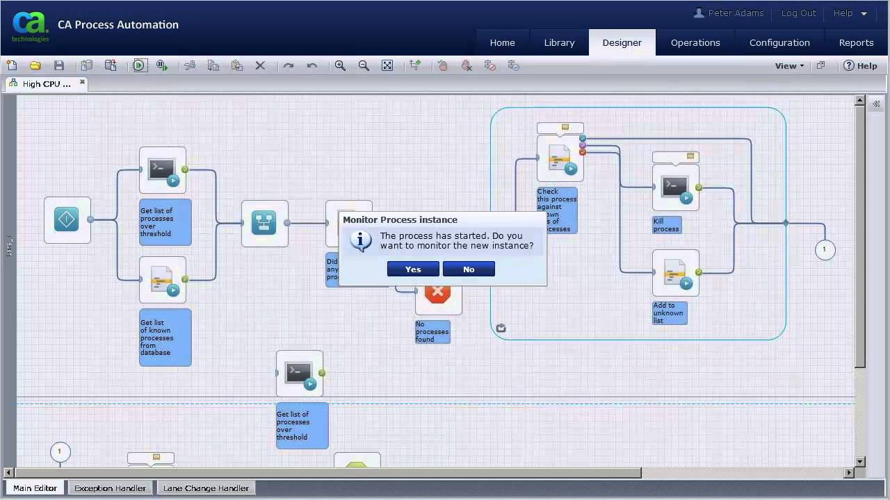

Slide 21


But most of the time I was doing it, my face looked like this:
I mean, it’s important… I guess.

Slide 22


Secretly, I had a burning desire to help people.
People are literally out there dying on the streets and I’m building... developer tools.

Slide 23


Secretly, I had a burnout desire to help people.
People are literally out there dying on the streets and I’m building... developer tools.

Slide 24



So, I came up with an idea…
What if I could use the tools I’m working on to help people?

Slide 25


I started my own non-profit and my face started to look like this:
Truly I have found my passion. Helping people brings me so much joy!

Slide 26
I used AI-based microservices to improve data collection from people experiencing homelessness.

Slide 27
“What do I need the most? Bro, I'm homeless. I need a house. If I had a house, I wouldn't be homeless.” Anonymous survey participant, Las Vegas, NV

Slide 28
What I did

Slide 29


Slide 30
I put 20+ people into stable long-term, stable housing

Slide 31
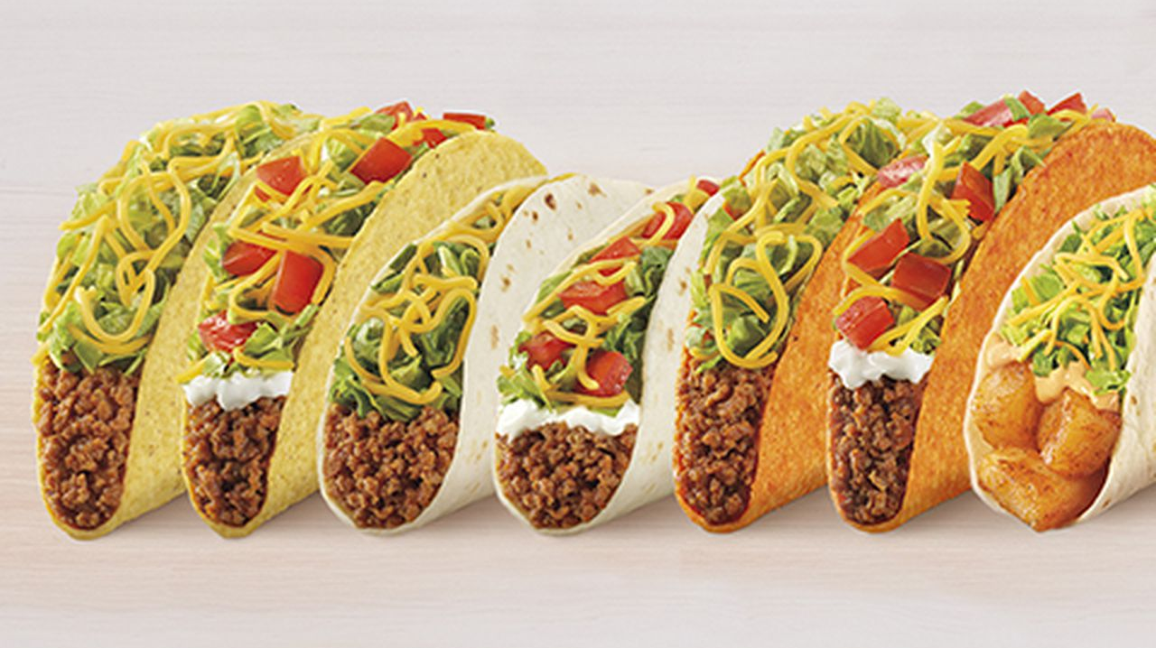

Slide 32
I fed more than 100 people in partnership with Taco Bell

Slide 33


Slide 34
I developed an AI-assisted volunteer chat program to talk to people experiencing homelessness via SMS that still exists today

Slide 35


Slide 36
I collected data via automated SMS question bots

Slide 37
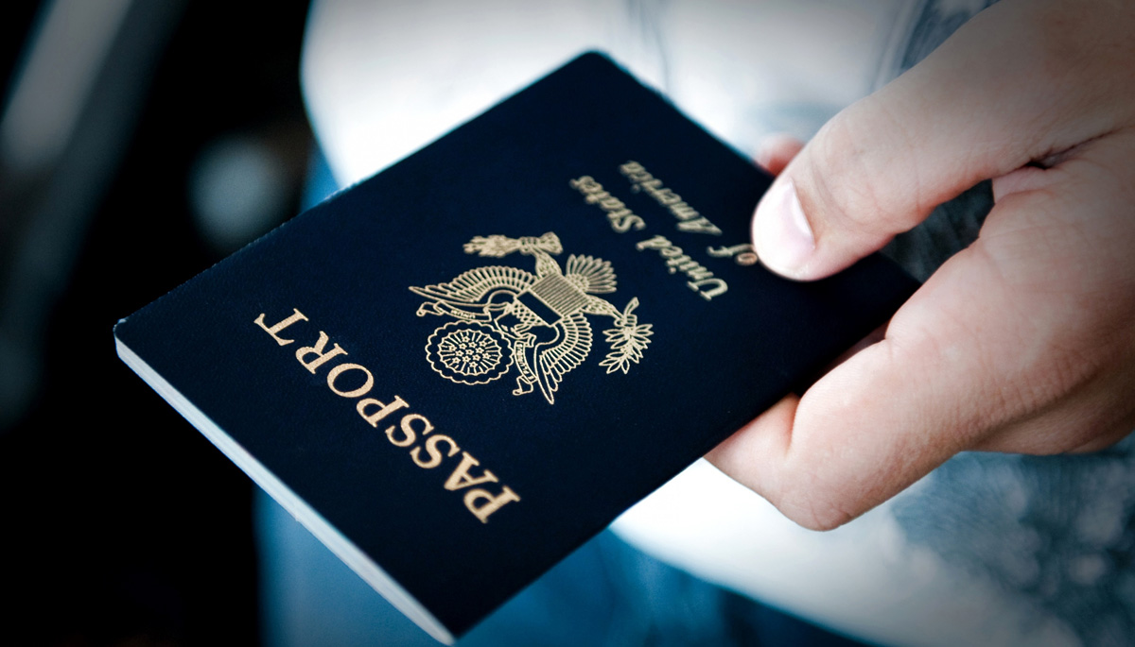

Slide 38
I helped dozens of people recover IDs and lost documents, including one in Ukraine

Slide 39


Slide 40
Advocated for our users at the local, state, federal government -- and all the way to the United Nations by sharing stories and data from their constituents

Slide 41

What can YOU do?

Slide 42



Where I thought the average non-profit was in terms of technology:
What I learned about non-profits

Slide 43

Where the average non- profit really is in terms of technology:
What I learned about non-profits

Slide 44








“Give me a lever long enough, and I can move the world.”
Archimedes

Slide 45

You have that lever
In the form of developer tools like JET

Slide 46
By building better development tools, you are helping people.

Slide 47
Those tools enable designers and developers like me to help more people.

Slide 48
Either directly or by freeing up time to volunteer after work.

Slide 49
I truly believe that building better development tools is the BEST way to provide social impact.

Slide 50


