Slide 1
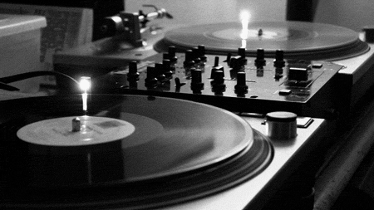
How to Turn Strangers into Promoters with Re-marketing
A Twenty Slide Crash Course for Entrepreneurs
Photo Credit: Danny Oliver

Slide 2

“The purpose of marketing is to turn strangers into promoters.”
Ryan Allis, United Nations Global Entrepreneurs Council

Slide 3

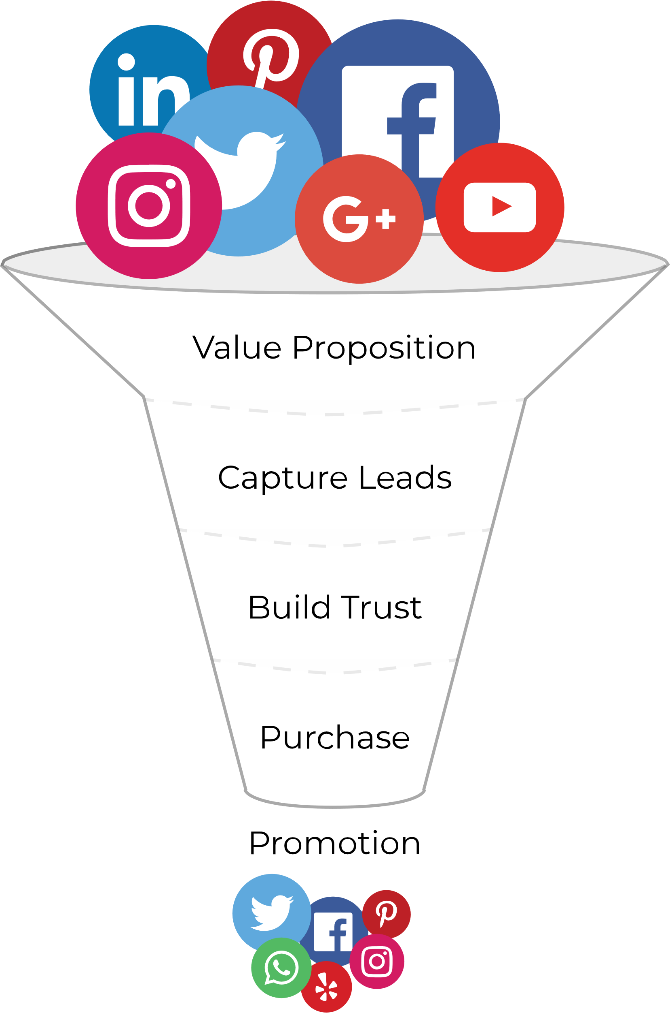
How to turn strangers into promoters
Value Proposition - Provide a clear and concise statement of
the value of your product -- who it is for and how will
they benefit?
Capture leads – by installing Google Analytics and the Facebook Pixel. Encourage email newsletter signups and social media engagement.
Build Trust through repeated contact through email newsletters
or social media.
Purchase
A good purchase and product experience is crucial. Retaining customers is cheaper than acquiring them in the first place.
Promoters!
People who love your product will promote your product.
Promotion

Slide 4
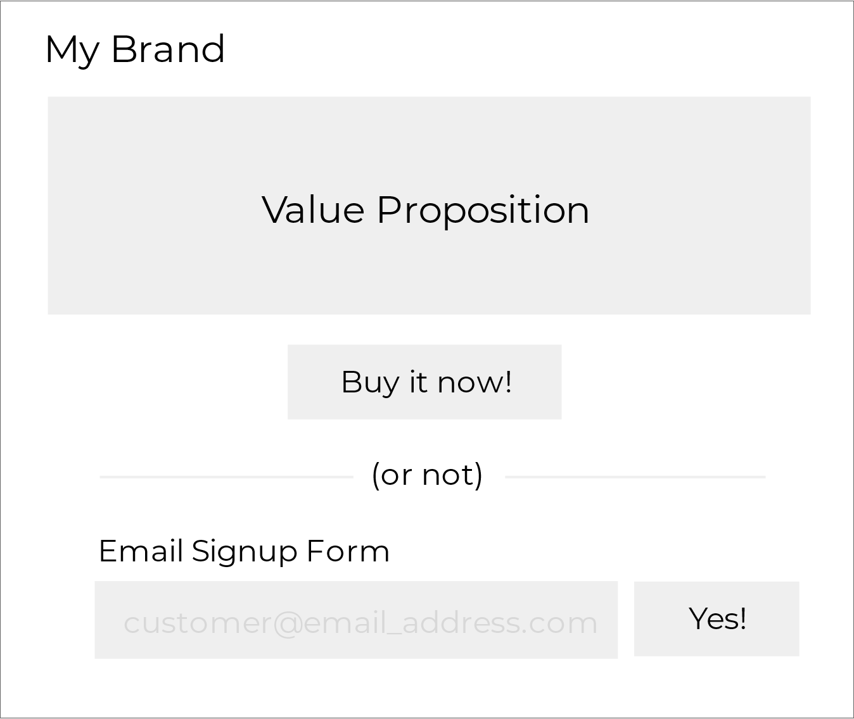

Step 1: Create a Landing Page
Ads
Promotion

Slide 5
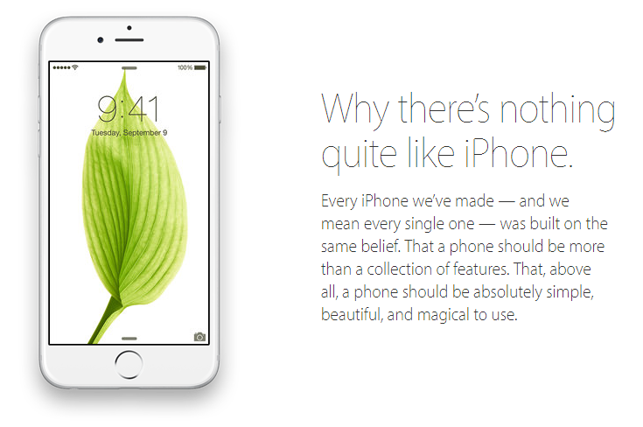
Give your customers a clear value proposition
A value proposition is a quick and concise statement of what your product is, who it is for, and what action you want the customer to take. Explain how that action will benefit them.
For example:
Sign up now to save 15% or more on
your car insurance.
This isn’t a hypothetical. Stop right now and go write one if you don’t have one already.
You’ll need it for the next step.

Slide 6


Step 2. Start Capturing Leads with your New Landing Page
Collect data from your landing page
Install Google Analytics and the Facebook Pixel on your landing page and make sure they are connected.
If there is a thank you or success page, make sure that analytics are installed there as well.
You will use these for re-marketing later.

Slide 7
Capture Leads with both Email and Social Media
Since not everyone will buy your product, it’s important to capture leads for an opportunity to market to them later.
Create an email signup form using an email marketing provider such as Constant Contact or MailChimp.
Position the email signup form below the purchase option near the bottom of your landing page, followed by social media links.

Slide 8
Step 3: Build Trust with Authentic Communication
  Create a short series of emails including a welcome email that introduces you and
  your brand, including social media channels and other authentic ways to engage
  with your brand.
  Have an active and engaging social media presence.
  Don’t try to sell people on your product. Just provide useful and relevant information
  about the product. Create a separate sales series for people who have begun a
  purchase but haven’t completed it, such as abandoned shopping carts.
  Run re-marketing ads to people who have been to your website to make your brand
  seem larger and more familiar to them.

Slide 9
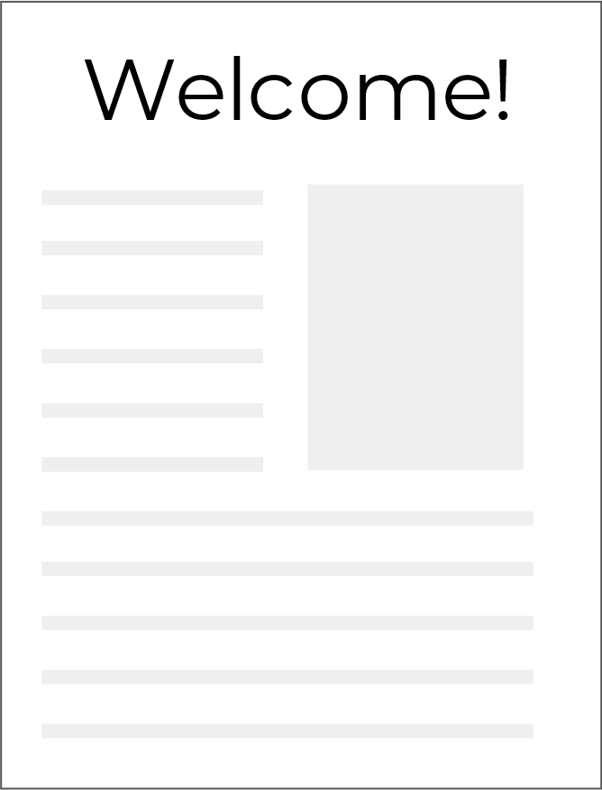
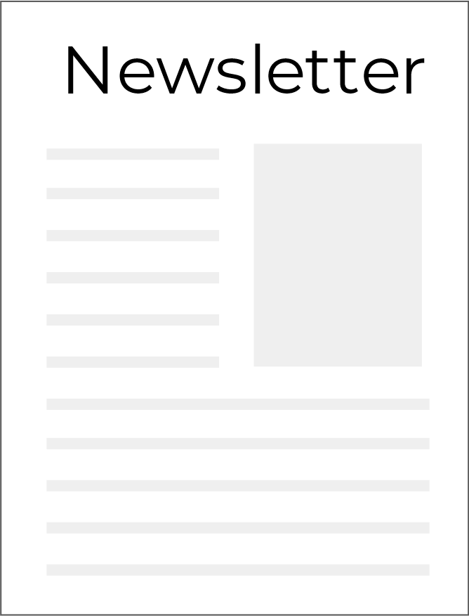
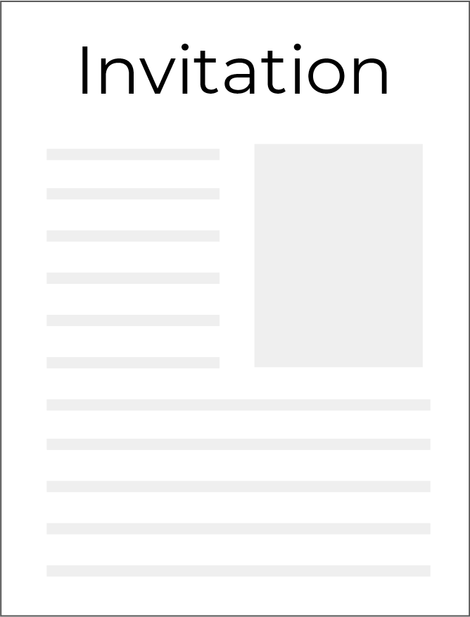
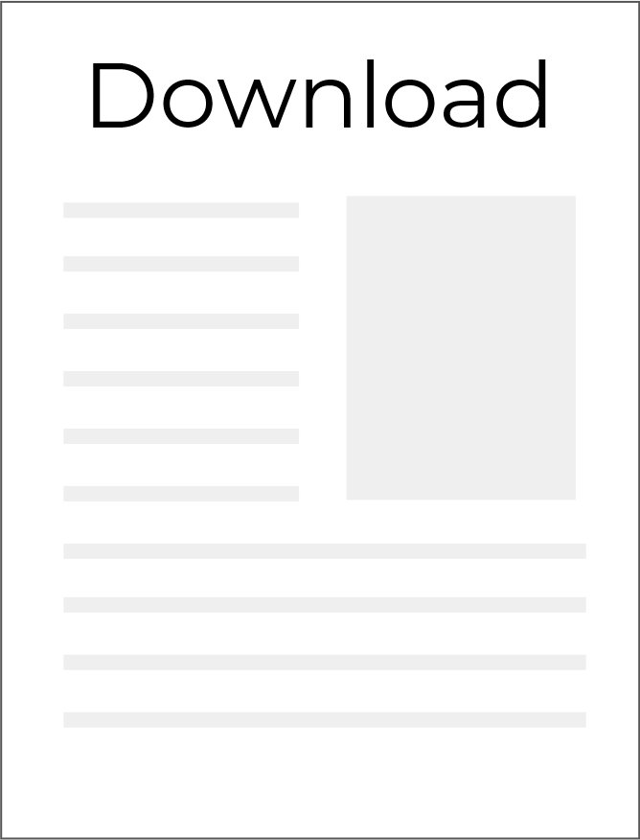
Create an Email Campaign
  You will probably want to offer something to
  encourage people to sign up, for example:
  Discounts and coupons
  Digital downloads such as PDFs or
  exclusive video content
  Contests or prizes
  Sometimes just communicating with your brand in
  an authentic and fun way can create an exclusive
  ambiance if you give an insider feel such as a fan club

Slide 10
Re-marketing (also called re-targeting)
After You’ve Created your Marketing Funnel
With re-marketing, after someone goes to your landing page, they start seeing your ads on other websites around the internet. Seeing your ads on major sites such as Facebook, Google, CNN, etc builds familiarity and trust and advertising on them can make your brand seem larger than life.
Look-alike Audiences
Segment your web traffic into groups – purchases, email signups, social media signups, etc., and create look-alike audiences for them on Facebook. Run ads to those groups.

Slide 11
How does re-marketing work?
It doesn’t matter if people click on your ads,
what’s important is that they see them.
Ads are sold in a unit called CPM which is the cost for 1,000 impressions (views)
It costs about $5 to buy 1,000 ads, which means your cost scales with your traffic.
Sending 1,000 ads to one person is far more effective than sending one ad to 1,000 people for the same price.

Slide 12
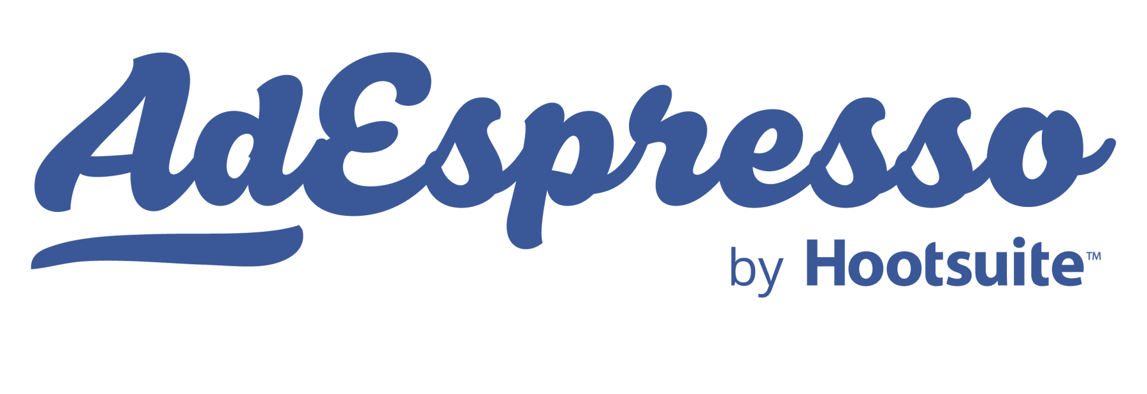

Start your Re-Marketing Campaign
Using the Facebook pixel that you installed on your landing page, begin re-targeting your customers on Facebook.
Then setup Google Remarketing using Google Adwords
Or use a product like MailChimp or AdEspresso to help with your remarketing campaign

Slide 13
Find More People Like your Customers
  Use Facebook to create “look-alike” audiences based on your segmented
  customer lists, website visits, and the email addresses you’ve collected to find
  people with similar interests and profiles.
  Run ads on Facebook to these audiences that send them to a landing page.
  Test different landing pages for effectiveness with different audiences.
  Aggressively cut the bottom of your lists. Cut the bottom 80%, create a new
  look-alike audience and start again.

Slide 14
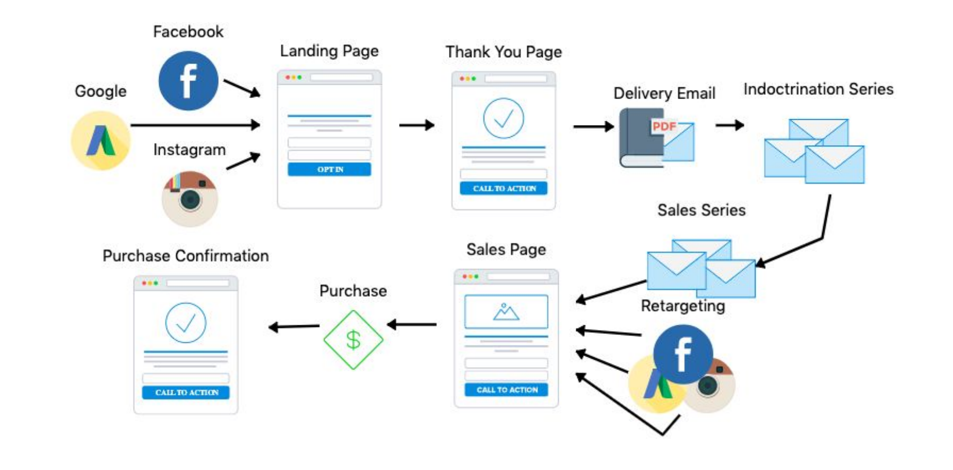
A simple example of a marketing funnel
Slide Credit:
Marcus McNeil, MAGIC Agency

Slide 15
Know your Unit Economics
Don’t worry -- marketing math isn’t “real” math.
Customer Lifetime Value
How much a customer is worth to you in revenue throughout their time as a customer.
Customer Acquisition Cost
Cost to you in revenue throughout their time as a customer
Net Promoter Score
“How likely are you to recommend us to a friend or colleague?”

Slide 16
Customer Lifetime Value
  CLV = How much a customer is worth to you in revenue throughout their time as a customer with your company
  Example:
  Avg monthly revenue per customer = $50
  Avg monthly churn = 3.3%
  Avg customer life = 30 months
  __________________________________
  Customer lifetime value = 50 x 33 = $1500

Slide 17
Customer Acquisition Cost
Take the inverse of your conversion rate.
CAC =
  Total monthly sales and marketing costs
  Total customers acquired in a month
  You can spend about 25% of your Customer Lifetime Value to acquire a new customer.
  Once you know your unit economics, you can spend as much or as little as you want
  on acquiring new customers. Spend about 10-15% of your CAC on exploring new channels!
  *Remember: retaining customers is cheaper than acquiring them. Retention increases CLV.

Slide 18
Net Promoter Score
Ask ALL of your customers this simple question and record the answers. Ideally this will not be anonymous, but it’s ok if it is. Better to get the answer than not.
“How likely are you to recommend us to a friend or colleague?”
0 1 2 3 4 5 6 7 8 9 10
Follow the NPS question with a feedback or comment form to allow your customers to share their experience with you.

Slide 19
Net Promoter Score
Learn who your promoters and detractors are, and
Get in touch with them.
Your Net Promoter Score is easy to calculate:
Subtract the percentage of respondents who are detractors from the percent who are promotors. That’s your NPS score!
9,10
7,8
0-6
= Promoters
= Passive
= Detractors
Example with 100 respondents (to make the math easy)
50 promoters
25 passive
25 detractors
25
NPS Score
50% - 25% =

Slide 20
Get in Touch!
This is only a basic marketing funnel. We can do SO much more if we work together. Reach out to me and I’ll send you a copy of my boilerplate marketing plan.
www.AlanUnderwood.com
Alan Underwood
alanunderwood@gmail.com
919-827-3185

